Slide 1



Course Tracker App
Group 10
Onyeze J Chineke
Noah Stephen Ferenczhalmy
Collin McAlister
Nidhi Parvathala
Sebastian Sarinana
Jesus Rafael Silva
Kayla Michelle Vaughn

Slide 2
Table of Contents
01
02
03
04
05
06
Project Objective
Cost & Budget
Timeline & Schedule
System Requirements
Diagrams
Architecture Design

Slide 3
01
Project Objective

Slide 4
Project Objective
We undertook this project specifically to build an all-in-one solution to viewing grades, the effects of future grades, GPA, and due dates. Currently, most of the features are scattered throughout different applications in the UTD portal (eLearning, Galaxy, etc). Our design is meant to be used by students at UTD, with the potential to be implemented at other campuses with similar platforms.

Slide 5
Incremental Process Model
We are using an incremental process model for our development for its constant feedback and improvement cycles. For each software increment, we will test and improve each feature.
Due to the nature of our projects features, each feature is able to be developed in isolation from one another and built upon incrementally, saving cost and time.
This modular and organized approach to development allows for consistent customer feedback and reduces risk during the development cycles.

Slide 6
02
Cost & Budget
Notes:
Sebastian

Slide 7


Hardware Costs
Supabase Pro | $25.00
Vercel Pro | $20.00
Total | $45.00

Slide 8


Software Costs
Domain Name Cost | $10.46
SSL Certificate | $0.00
React + Vite | $0.00
Total | $10.46

Slide 9
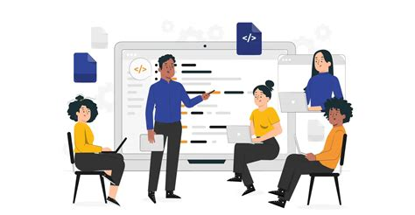
Personnel Costs
Development Costs | $0.00
End User Training | $40-$60
Total | $40-$60

Slide 10
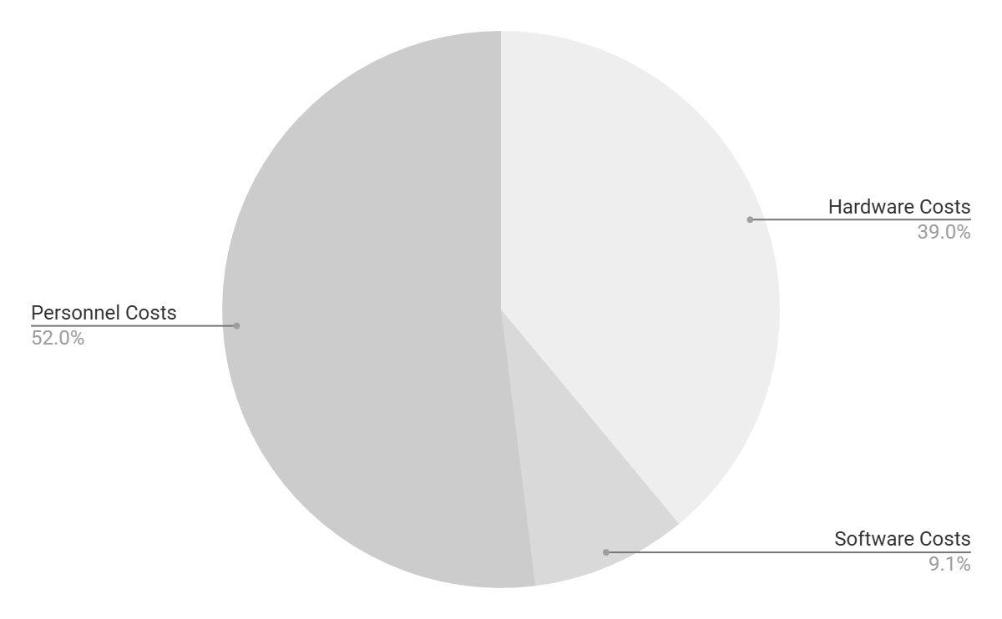
Budget
Hardware
$45.00
Software
$10.46
Personnel
$60.00
Estimated Total: $115.46

Slide 11
03
Timeline & Schedule
Notes:
Nidhi

Slide 12
Project Timeline
Phase 1
Phase 2
Phase 3
Phase 4
Requirements Check
Backend Development
Frontend Development
Integration & Testing
Phase 5
QA Testing/Deployment

Slide 13
Scheduling
The start date of this project will be: January 12, 2025 - March 2, 2025
Project will take around 7 weeks
No work on weekends, 9-5 (8 hours per day), Monday - Friday
Team size: 7
Requirements check, architecture plan, and UI design (1 week)
Backend development (2 weeks)
Frontend development(2 weeks)
Integration & system testing (1 week)
QA testing/Deployment (1 week)
[1]

Slide 14
Development Schedule
Phase | W 1 | W 2 | W 3 | W 4 | W 5 | W 6 | W 7
Requirements Check
Backend Development
Frontend Development
Integration & Systems Testing
Quality Assurance Testing & Application Launch |  |  |  |  |  |  | 🎉

Slide 15
04
System Requirements
Notes:
Onyeze

Slide 16
Functional Requirements
The user shall be able to see all assignments assigned in Blackboard for the current semester
The system shall generate assignment notifications according to the user’s preferences
The user shall be able to request summaries of data for a specific month
The user shall be able to request summaries of data for a specific week
The user shall be able to request summaries of data for a specific day
The user shall be able to add additional/custom assignments not found on Blackboard
The user shall be able to search their classes
The user shall be able to sort their classes

Slide 17
Non-Functional Requirements
Users should connect the system to their Blackboard account using their credentials
The software should be easy for the user to navigate
The system shall be able to run on mobile and desktop hardware through a web browser
Notifications from the system should be sent promptly according to when they are scheduled
The software shall not expose PII to unauthorized actors and shall maintain the security of information
The system should not miss any assignments from the user’s Blackboard account

Slide 18
05
Application Diagrams

Slide 19
Use Case Diagrams
Notes:
Noah

Slide 20
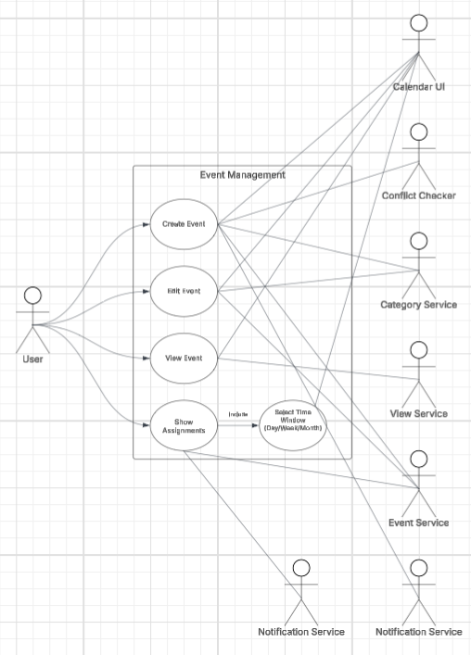
Event System

Slide 21
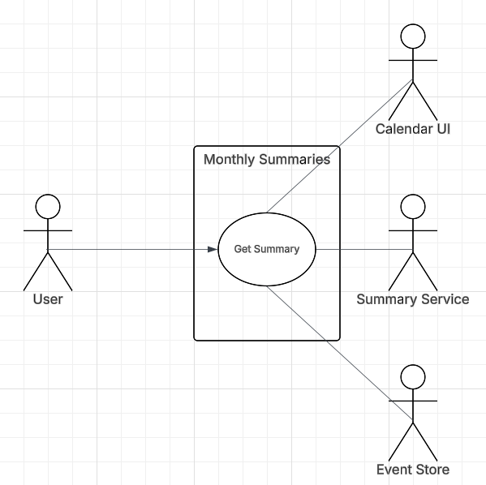
Monthly Summaries

Slide 22
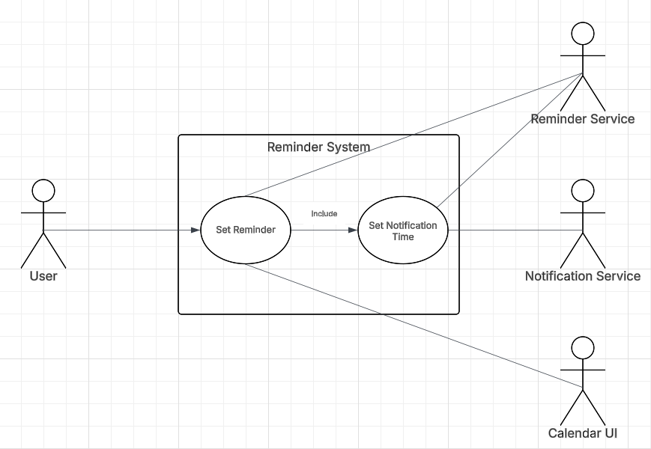
Reminder System

Slide 23
Sequence Diagrams

Slide 24
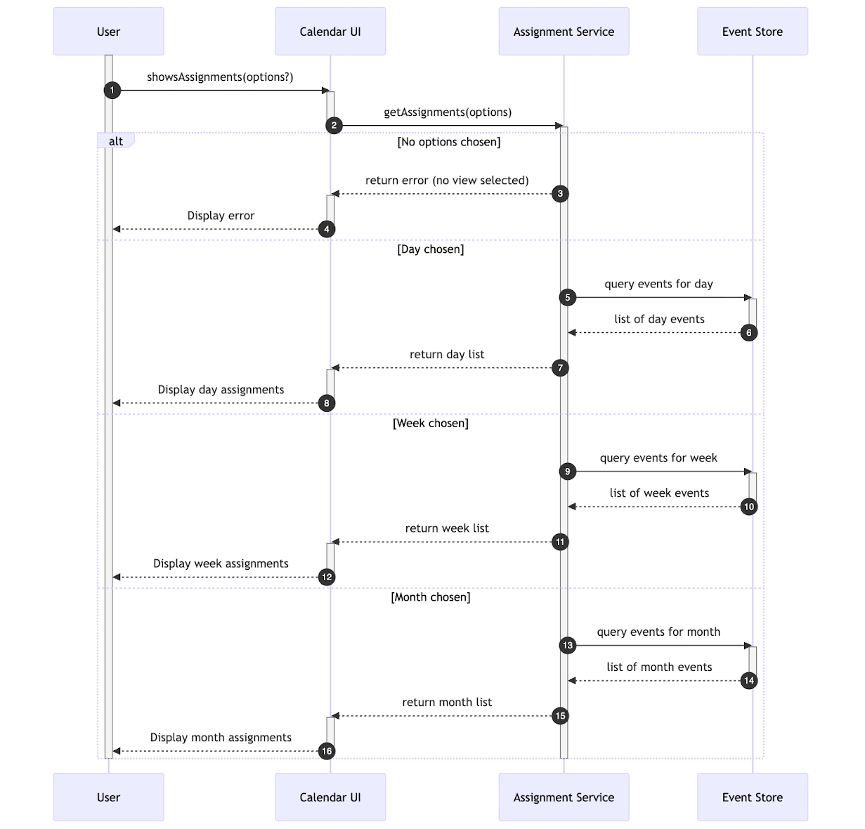
Show Assignments

Slide 25
Class Diagram

Slide 26
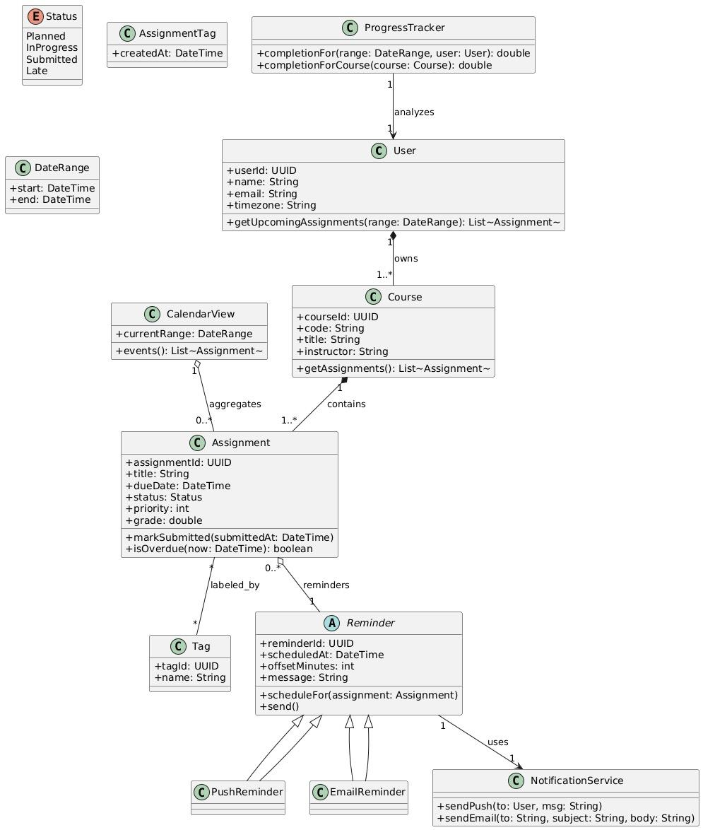
Class Diagram
Core chain: User → Course → Assignment
Tags for filtering
CalendarView for time-range display
Reminders (Push/Email) + NotificationService
ProgressTracker for completion stats

Slide 27
06
Architectural Design
Notes:
Presenter for Architecture: Collin

Slide 28
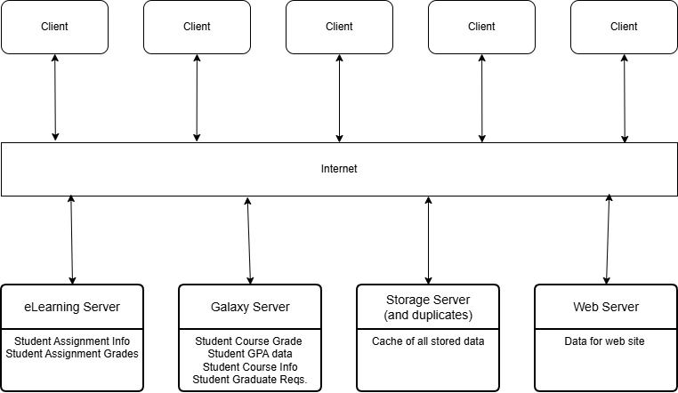
Client Server Architecture
Notes:
This is a multiuser, web-based system for viewing and compiling data based on an individual student’s grades and GPA at UTD. In this system, several servers manage and display varying data. The eLearning and Galaxy Servers need to have a fast and secure response, with the Galaxy server not needing to worry about as many concurrent requests. The eLearning server has to handle most of the initial requests from a student’s client.
The Storage Server acts as a secure container in order to separate the storage of personal information of the students, and to limit requests to the eLearning and Galaxy servers. This server will have multiple duplicates in order to ensure maximal reliability, security, and scalability.
The Web Server contains all of the framework for the app and is responsible for handling all of the traffic through the system as a whole. The client program is a simple integrated user interface, constructed using a web browser to access the service.

Slide 29
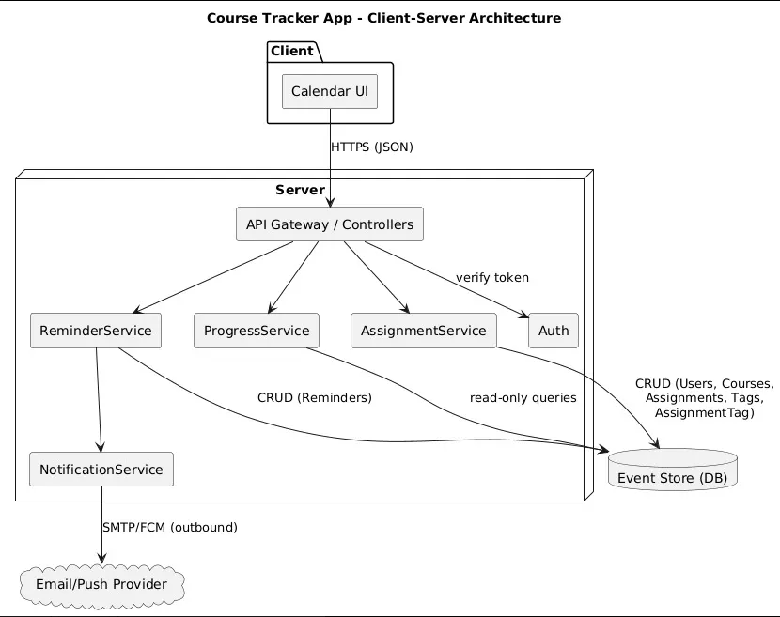
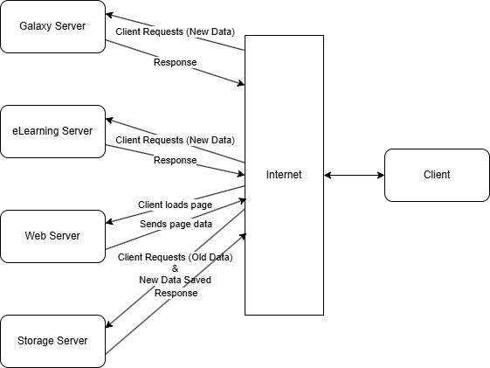
Client Server Architecture

Slide 30
References
[1] I. Sommerville, “Software Engineering Tenth Edition,” 2016. Available: https://dn790001.ca.archive.org/0/items/bme-vik-konyvek/Software%20Engineering%20-%20Ian%20Sommerville.pdf
[2] “Branding | Supabase,” Supabase, 2025. https://supabase.com/brand-assets
[3] Vercel, “Develop. Preview. Ship. For the best frontend teams – Vercel,” vercel.com. https://vercel.com/
[4] Meta Open Source, “React,” react.dev, 2025. https://react.dev/
[5] Vite, “Vite,” vitejs, 2024. https://vite.dev/
[6] “EDOXI,” EDOXI, 2020. https://www.edoxi.com/studyhub-detail/top-software-training-institutes-india (accessed Nov. 23, 2025).

Slide 31
Thank you

